Slide 1

One LMS,
Not 12 Training Tools
The operating system for training proof, not another place to store courses.
9:00 AM PT • SafetyNow
SafetyNow
Notes:
Open by saying this session is not really about buying an LMS. It is about replacing training sprawl with a reliable operating system for evidence, readiness, and action.

Slide 2
The problem is not training. It is fragmentation.
Every workaround creates another version of the truth.
HRIS
Email
Excel
Folders
roles
reminders
matrix
certificates
Vendor portals
Supervisor binders
Payroll
Incident files
courses
sign-offs
status
evidence
If proof lives everywhere, proof lives nowhere.
SafetyNow
Notes:
Use this as a systems map. Explain that organizations rarely choose this; they inherit it because each team solves a piece of the problem independently.

Slide 3
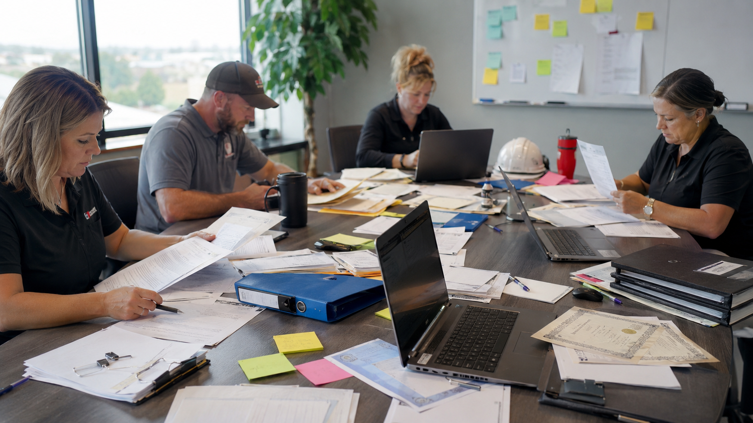
The audit does not ask where you hoped the record was.
It asks what you can produce, how fast you can produce it, and whether the record tells the whole story.
Presenter context: OSHA Training Requirements in OSHA Standards, OSHA 2254; WorkSafeBC training and orientation guidance.
SafetyNow
Notes:
The point is not fear. The point is practical defensibility. A sign-in sheet or certificate may be useful, but it usually does not prove why training was required or whether the worker could apply it.

Slide 4
Design the system around the worker journey.
Not around the software menu.
1
2
3
4
5
6
Hired
Assigned
Trained
Observed
Cleared
Renewed
role + site
training path
content + quiz
supervisor check
ready status
expiry + trigger
The LMS should answer: who is ready to work today?
SafetyNow
Notes:
This is the core design principle for the deck: a training system is a readiness system. It should show status and action by worker, site, hazard, and role.

Slide 5
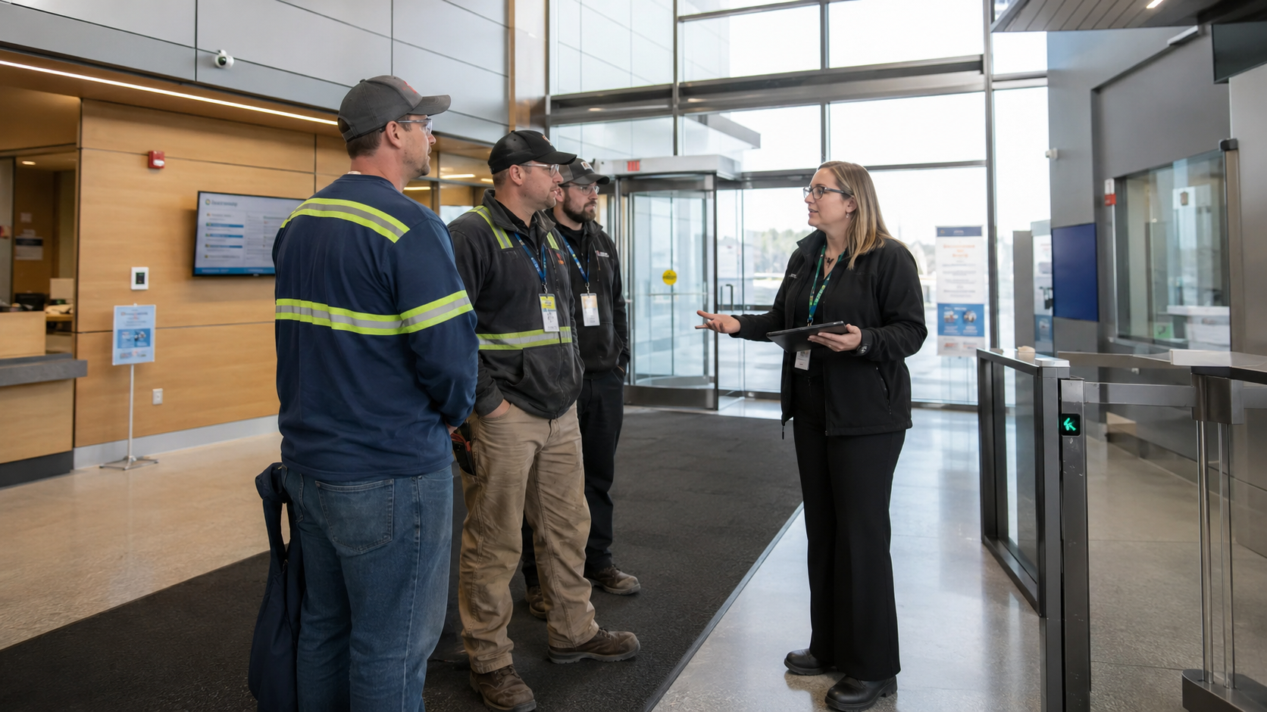
Give every worker a training passport.
Role. Site. Hazards. Completions. Expiries. Restrictions. Supervisor checks.
Role
Site
Hazards
Courses
Expiries
Restrictions
Supervisor check
SafetyNow
Notes:
Explain that the passport idea is practical: a supervisor should not need to inspect six systems before assigning work.

Slide 6
Start with risk, not course names.
Role
Hazard
Training
Proof
Forklift operator
Traffic + load
Operator + site rules
Completion + observation
Maintenance
Energy + guarding
LOTO + machine-specific
Procedure walkdown
Supervisor
Crew readiness
Due diligence + follow-up
Exception report
Contractor
Site exposure
Orientation + task scope
Pre-job approval
A matrix turns an LMS into a control system.
SafetyNow
Notes:
Show that the matrix is the bridge between compliance and operations. It prevents overtraining and undertraining.

Slide 7
Managers need signals, not spreadsheets.
Ready
Restricted
Cleared for assigned work
Missing required proof
Expired
Needs check
Do not assign to task
Supervisor verification due
A good system tells the supervisor what to do next.
SafetyNow
Notes:
A key departure from a course library is actionable status. This is where software begins to change behavior.

Slide 8

The executive view should be boring.
No mystery. No exceptions hiding in local files. No last-minute audit scramble.
COVERAGE
GAPS
OVERDUE
EXPIRING
RESTRICTED
VERIFIED
SafetyNow
Notes:
The best executive dashboard is not overloaded. It shows whether risk-based training is under control and where action is needed.

Slide 9
Twelve tools should become one workflow.
Course vendor
HR spreadsheet
One assignment engine
Email reminder
One evidence record
PDF certificate
One exception report
Supervisor binder
Incident file
The value is not fewer logins. It is fewer gaps.
SafetyNow
Notes:
Make this practical. Consolidation is not a technology goal. It is a risk reduction and productivity goal.

Slide 10
A 30-day consolidation sprint.
Days 1–5
Days 6–15
Days 16–30
Find every active training source
Map roles, hazards, sites
Migrate active records
Identify duplicated admin work
Build the first training matrix
Launch exception reporting
Start where the audit risk and administrative pain are highest.
SafetyNow
Notes:
Give the audience a concrete next step. They do not need a perfect migration project to begin.

Slide 11
One LMS is not the goal.
One source of training truth is.
That is the takeaway: simplify the system so readiness is visible before work begins.
SafetyNow
Notes:
Close by tying the message to operational readiness, not LMS features.

Slide 12
Presenter source notes
1. OSHA Training Requirements in OSHA Standards, OSHA 2254.
2. OSHA training standards policy, language and vocabulary workers can understand.
3. WorkSafeBC guidance on training, orientation, and worker supervision.
4. BLS Census of Fatal Occupational Injuries, 2024 release.
5. AWCBC National Work Injury / Disease Statistics Program for Canadian data context.
SafetyNow
Notes:
These are presenter references and should not be read during the webinar.

