Slide 1

SafetyNow
Post-incident readiness
What Happens
After the Incident
How LMS-based training records help employers answer the first questions asked after an incident.
For safety leaders, HR, operations, supervisors, and business owners
01

Slide 2

SafetyNow
The shift
THE MOMENT EVERYTHING CHANGES
An incident turns training into evidence.
The conversation moves from “we trained people” to “show us who, when, what, why, and whether it matched the task.”
Who was trained?
What content was covered?
Did it match the task?
Were refreshers assigned?
02

Slide 3
SafetyNow
Post-incident sequence
THE FIRST REQUEST IS RARELY PHILOSOPHICAL
It is usually a record request.
Incident investigation, regulator review, insurer inquiry, legal discovery, internal audit, client requirement.
1
2
3
4
5
Incident reported
Supervisor response
Investigation opens
Training records pulled
Corrective training assigned
The quality of the answer depends on the system that existed before the event.
03

Slide 4
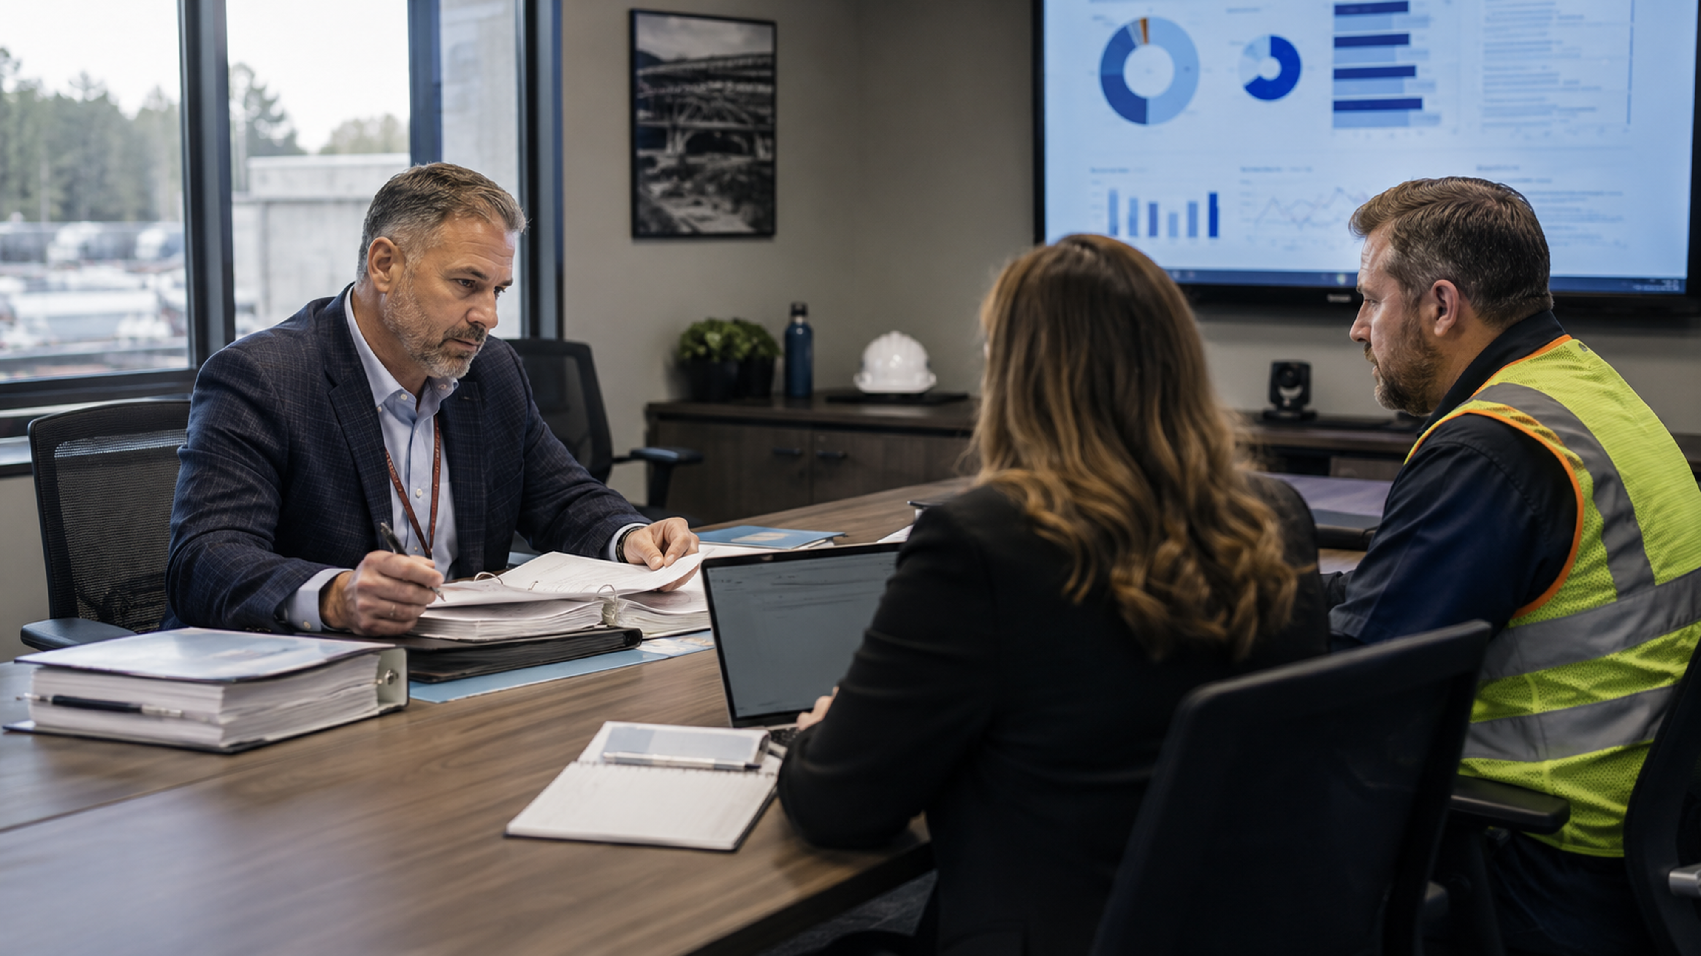
SafetyNow
Risk lens
THE WEAK ANSWER
“We think he took that course.”
After an incident, uncertainty creates risk. It also forces safety, HR, and operations to reconstruct the story from fragments.
Scattered files
Generic records
No audit trail
Old spreadsheets
No task match
No version history
04

Slide 5
SafetyNow
Defensible record model
THE EVIDENCE CHAIN
A strong record answers five questions.
WHO
WHAT
WHEN
MATCH
ACTION
the worker, role, site, supervisor
course, topic, version, policy
date, expiry, refresher status
task, hazard, equipment, work area
corrective training, closeout, proof
From “we delivered training” to “we can prove readiness.”
05

Slide 6
SafetyNow
McKinsey-style diagnostic
RECORD QUALITY DIAGNOSTIC
Would your record survive the first review?
WEAK RECORD
DEFENSIBLE RECORD
Sign-in sheet
Training assigned in LMS
Attendance only
Completion, score, version
Generic topic
Mapped to task and hazard
No refresher trigger
Automated renewal path
Manager unaware
Supervisor dashboard visibility
06

Slide 7
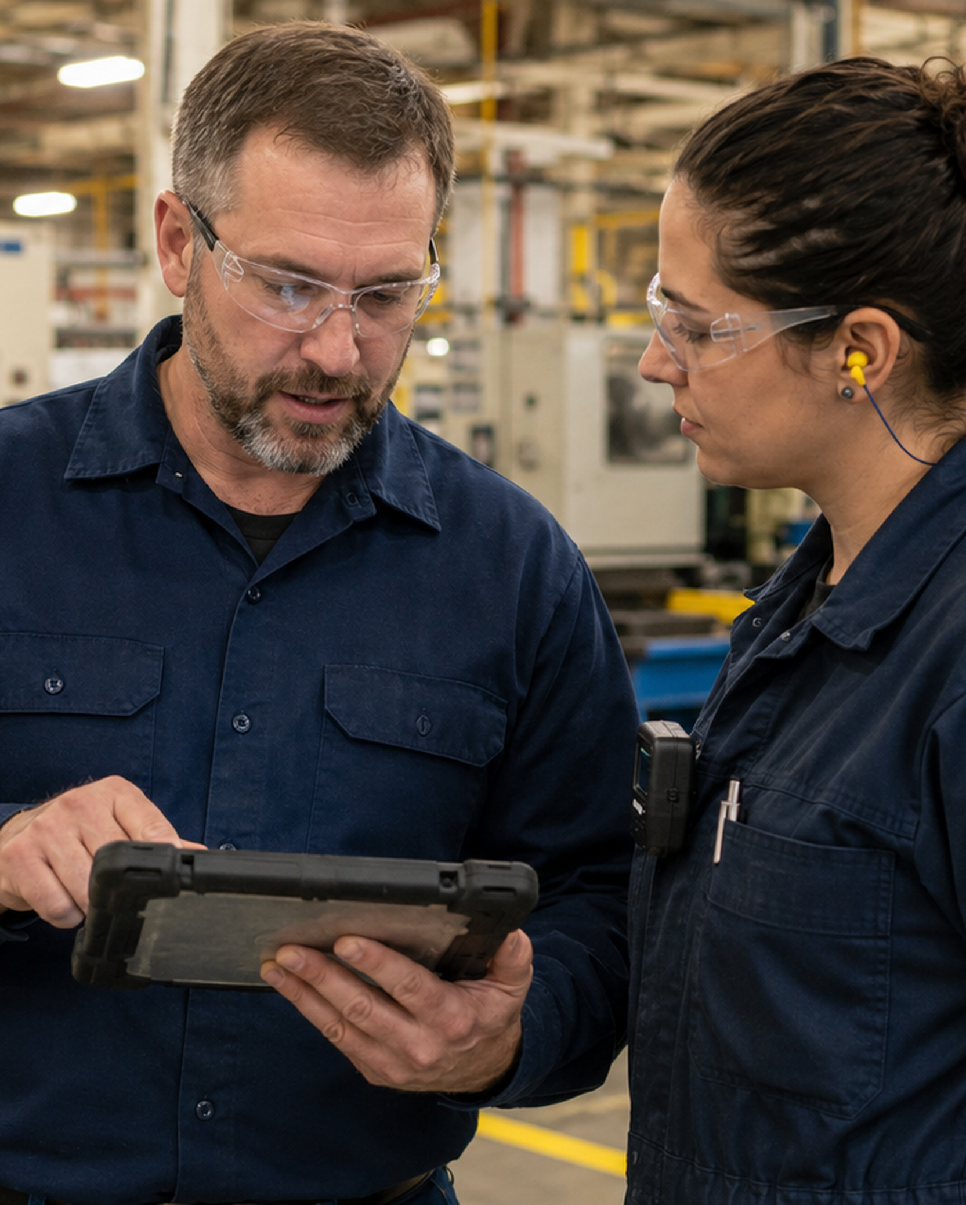
SafetyNow
Task match
THE DEFENSIBILITY TEST
Training must match the work.
A course title is not enough. Investigators look for the connection between worker, task, hazard, equipment, and site.
Worker
role / experience
Task
steps / conditions
Hazard
energy / exposure
The right evidence connects all three.
07

Slide 8

SafetyNow
Audit trail
WHAT CHANGES THE CONVERSATION
Audit trails show what happened before anyone asked.
Assignment date
Completion date
Course version
Score / acknowledgement
Admin changes
Refresher history
After an incident, a timestamp can matter as much as the training record itself.
08

Slide 9

SafetyNow
Pre-incident readiness
THE BEST POST-INCIDENT RECORD IS BUILT PRE-INCIDENT
Do not wait for the request.
Before
After
Assigned by role and task
Evidence pack ready
Supervisor sees gaps
Corrective learning tracked
Automated refreshers
Trend visible
09

Slide 10
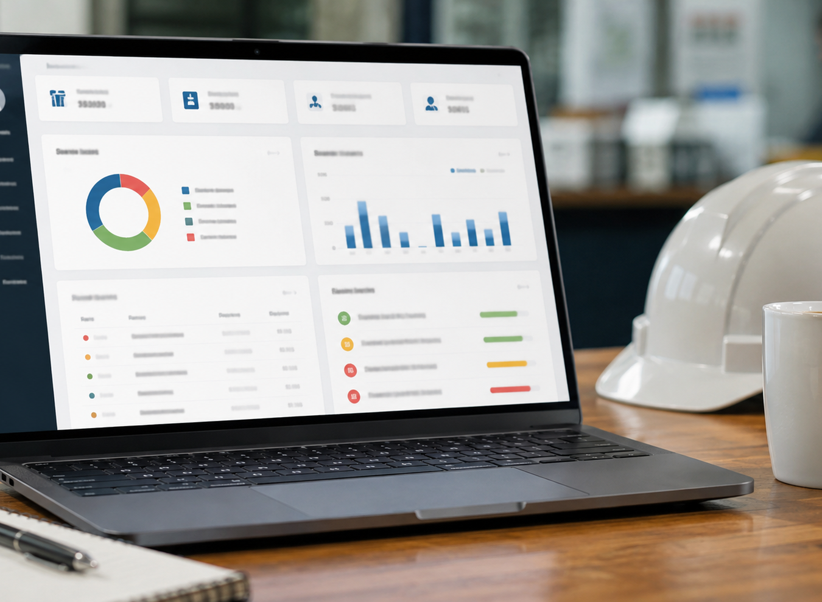
SafetyNow
Supervisor visibility
THE FRONTLINE PROBLEM
Supervisors cannot manage what they cannot see.
Incident readiness requires role-level visibility before the job starts, not record hunting after someone is hurt.
Training gap
Expired refresher
See it before assignment
Block or escalate
New task
Incident trend
Assign before exposure
Trigger correction
10

Slide 11
SafetyNow
Corrective training
AFTER THE INVESTIGATION
Corrective training must close the loop.
1
2
3
4
Cause or gap identified
Training assigned
Completion tracked
Supervisor verifies change
11

Slide 12

SafetyNow
Refresher logic
NOT EVERY INCIDENT NEEDS THE SAME RESPONSE
Incident
Corrective training
Near miss
Targeted refresher
Use triggers, not memory.
Procedure change
Update assignment
A defensible LMS workflow connects event type to learning response and proof of completion.
Role change
New task curriculum
Expired record
Auto-renewal
12

Slide 13
SafetyNow
Evidence pack
WHAT YOU WANT TO PRODUCE QUICKLY
One evidence pack, not six searches.
Worker profile
Training history
Course content
role, location, supervisor
courses, dates, scores
title, version, topics
Task map
Corrective record
Supervisor view
training linked to hazard
assigned, completed, closed
gaps known before incident
“
When the question comes, speed and consistency matter.
13

Slide 14
SafetyNow
SafetyNow workflow
HOW SAFETYNOW SUPPORTS READINESS
Assign. Track. Refresh. Prove.
The system matters because the incident review will ask for a complete story, not a single certificate.
Assign
Track
Refresh
Prove
role/task curricula
completion and gaps
expiry and corrective
audit-ready records
14

Slide 15

SafetyNow
Balanced message
THE PURPOSE IS NOT HIDING WEAKNESS
The record should help you learn.
A good LMS record supports investigation, corrective action, coaching, trend analysis, and prevention. It does not replace root-cause analysis.
Defend what was done
Find what was missing
Assign what must change
15

Slide 16
SafetyNow
Operating model
POST-INCIDENT READINESS IS SHARED
Four teams need the same record.
Safety
investigation, corrective action
HR
worker file, role, history
Operations
task match, supervisor follow-up
Leadership
risk trend, assurance
One source of truth reduces friction when pressure is highest.
16

Slide 17
SafetyNow
Implementation plan
START SMALL. BUILD CONFIDENCE.
A 30-day readiness sprint.
Week 1
Week 2
Week 3
Week 4
Map high-risk roles and required training
Clean historical records and gaps
Build refresher and corrective workflows
Test the evidence pack with one scenario
Test the system before the incident tests it for you.
17

Slide 18
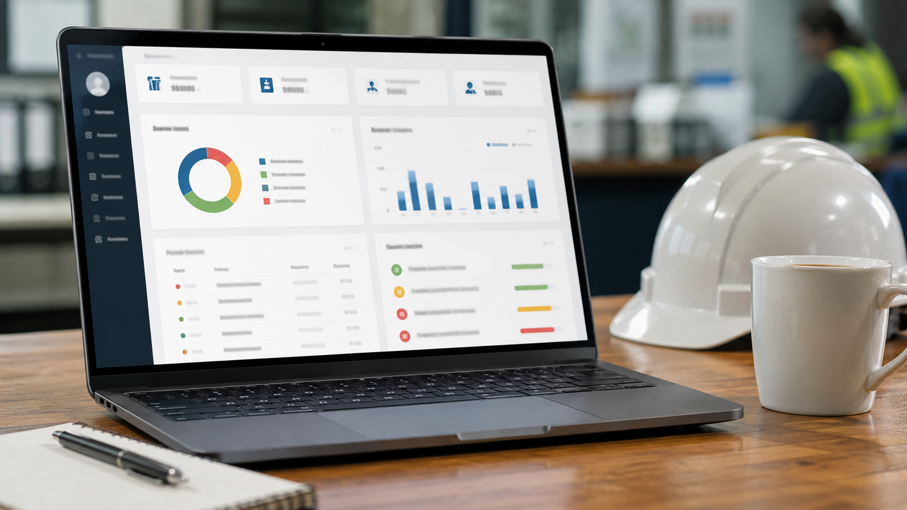
SafetyNow
Takeaways
REMEMBER THESE THREE THINGS
The incident review starts before the incident.
1
Centralize the record
2
Match training to the work
3
Close the corrective loop
If you cannot prove it quickly, consistently, and by task, the record is not ready.
18

Slide 19

SafetyNow
Close
Questions?
What would your organization be able to prove in the first 30 minutes after an incident?
Rick Tobin
RickT@SafetyNow.com
20

Slide 20
SafetyNow
Presenter source notes
SOURCE NOTES AND CAUTION
Use this as general guidance.
Recordkeeping, investigation, privacy, union, litigation, and training duties vary by jurisdiction, industry, hazard, and standard. Get legal advice for specific matters.
OSHA Recordkeeping
osha.gov/recordkeeping
OSHA Forms 300 / 300A / 301
osha.gov/sites/default/files/OSHA-RK-Forms-Package.pdf
CCOHS Incident Investigation
ccohs.ca/oshanswers/hsprograms/investig.html
CCOHS Due Diligence Documentation
ccohs.ca/oshanswers/legisl/legislation/diligence.html
WorkSafeBC Employer Investigations
worksafebc.com/en/health-safety/create-manage/incident-investigations
SafetyNow helps employers assign, track, refresh, and produce training evidence before questions are asked.
19

